Slide 1
Framework comparison
Interlace

Slide 2
Requirements
Web application, not a website.
Mobile application.
Client-server platform.
Easily scalable.
Easy learning curve.
“Reasonably” real-time.
Preferably one programming language.

Slide 3
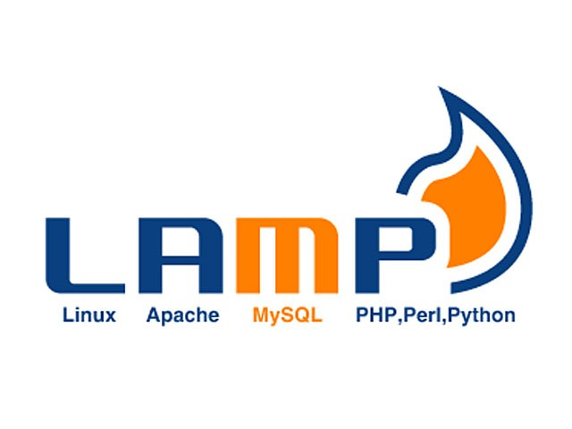
LAMP summary
Linux, Apache, MySQL, PHP/Perl/Python
Been popular for very long, great support online.
Built on extremely stable and sturdy technologies.
Not platform independent.
Multiple languages to learn.
Not suitable for mobile applications.

Slide 4

MEAN summary
MongoDB, ExpressJS, AngularJS, NodeJS
Operating system independent.
Single language required (JavaScript).
A lot of wiring up needs to be done by ourselves.
Moderate to steep learning curve.

Slide 5
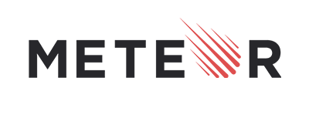
METEOR summary
Meteor = MEAN stack + Socket.IO + grunt + hot code reload + a lot more.
Mobile & Web app development with same code base.
Very easy learning curve.
Very little or no wiring up required between server and client.
Database limitation to MongoDB.

Slide 6
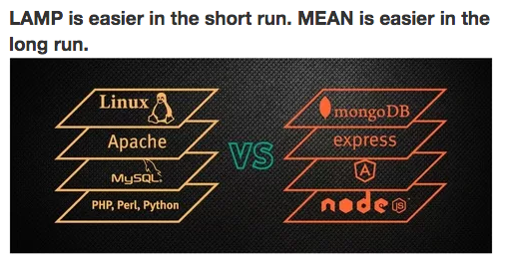
Comparison

Slide 7
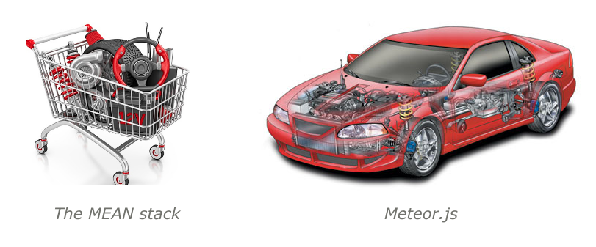
Comparison

Slide 8
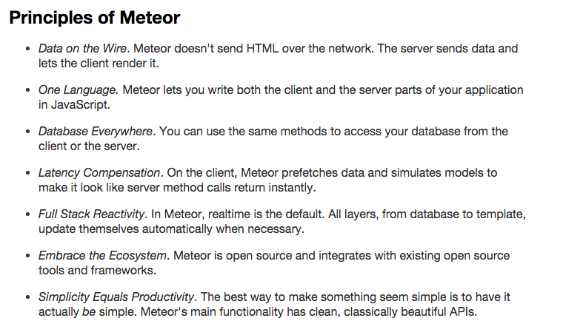
Recommendation: Meteor

